Slide 1


AUTOMATIC CHECK OF EXPLAINABILITY METHOD USING SALIENCY MAPS
TEAM: Daniele Riccobene (1000067662), Dario Scuderi (1000067670)
Cognitive Computing and Artificial Intelligence Course
University of Catania, Italy

Slide 2

outline
Introduction
Goals
Dataset Preparation
Training of M1 model
GradCAM
IoU as comparison method
Results & Conclusions

Slide 3
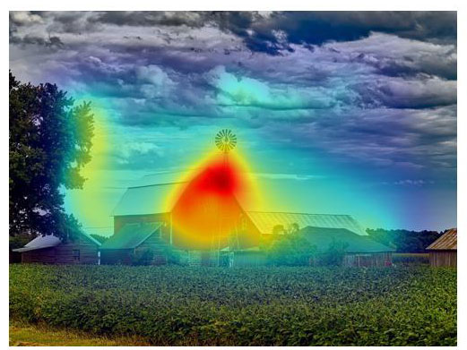
Introduction
Saliency Map: visualization technique used in Explainable AI (XAI) to highlight the most important parts of an input, that contribute to a machine learning model prediction.
Grad-CAM, or Gradient-weighted Class Activation Mapping: technique used to visualize and understand the predictions of Convolutional Neural Networks (CNNs).
SUM: pre-trained model that produces reference saliency maps.
Notes:
3

Slide 4
Goals
Training a custom model M1 (based on ResNet 18) on a reduced version of ImageNet10.
Applying GradCAM on M1 and ResNet50 (pre-trained).
Compare the output, that represents where the model has focused on, with the Saliency Maps produced by SUM.
Evaluate such maps using the Intersection over Union (IoU) metric.

Slide 5
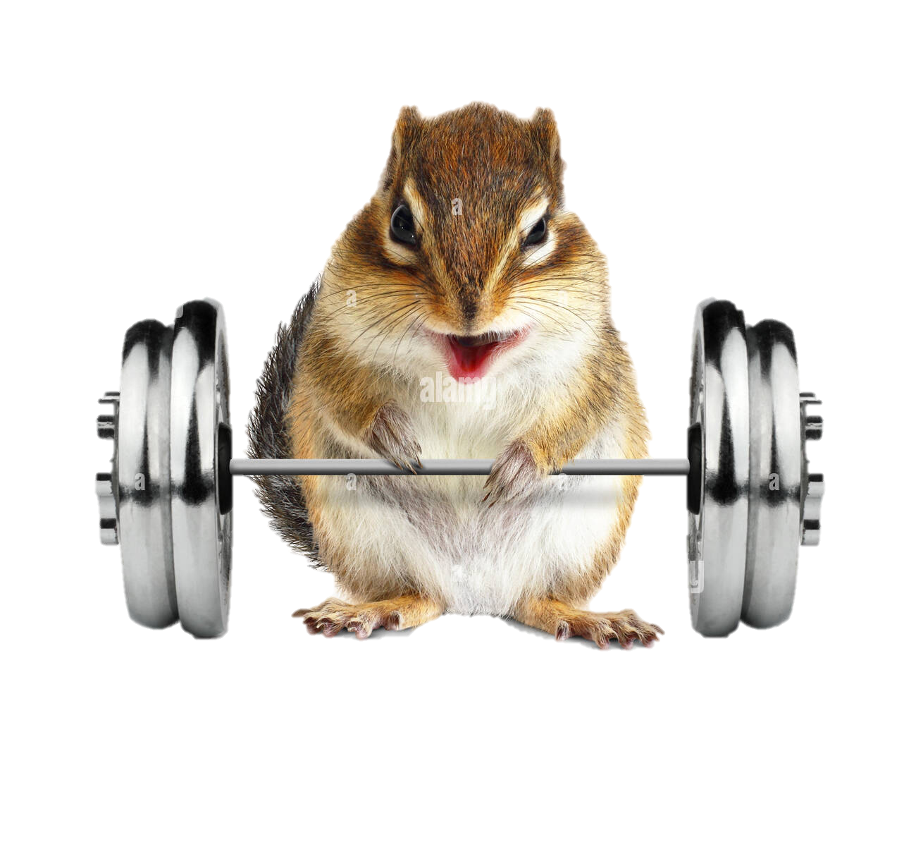
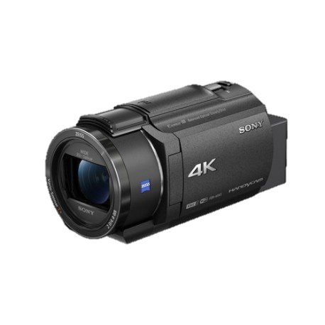
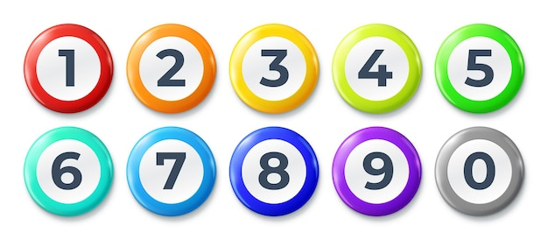
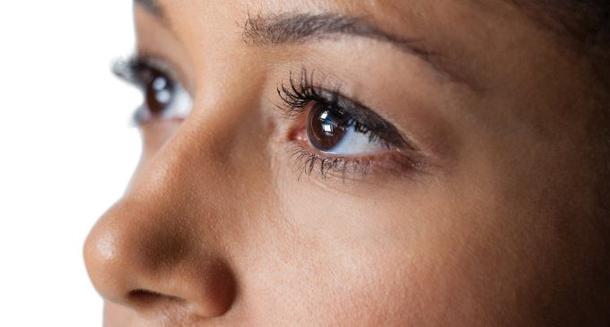
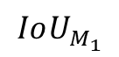
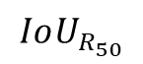
Graphically…
M1 Model
GradCAM
$$IoU_{M_{1}}$$
SUM
$$IoU_{R_{50}}$$
R50 Model
GradCAM

Slide 6
Dataset Preparation
A lightweight version of ImageNet10 was used, for a matter of computational cost and time; in particular, we chose only three classes out of the full set.
All images were resized to 224×224 pixels and transformed into tensors using standard PyTorch preprocessing pipelines.
To enable model training and evaluation, we randomly split the dataset into:
80% for training
20% for validation

Slide 7
M1 Training
To evaluate GradCAM-based Saliency Maps on a custom model, we trained M1, a modified version of ResNet18.
Key aspects of the training process:
Training from scratch (no pre-trained weights).
Loss Function: Cross-Entropy Loss.
Optimizer: Adam with a learning rate of 1e-3.
Training Duration: 20 epochs.
Device: GPU (cuda) when available, fallback to CPU.

Slide 8
Training Results
Epoch 1 - Train Loss: 0.6827 - Val Accuracy: 72.05%
Epoch 2 - Train Loss: 0.4533 - Val Accuracy: 81.28%
Epoch 3 - Train Loss: 0.3694 - Val Accuracy: 88.72%
…
Epoch 19 - Train Loss: 0.0348 - Val Accuracy: 92.95%
Epoch 20 - Train Loss: 0.0573 - Val Accuracy: 94.23%
Notes:
In mezzo ci sono fluttuazioni dell’accuracy, ma la loss scende sempre (a conferma del fatto che il modello sta sbagliando sempre meno e quindi sta imparando)

Slide 9
GradCAM
To interpret the model's decisions, we applied GradCAM (Gradient-weighted Class Activation Mapping) to both models.
Key parameter of our implementation:
Target Layer: "layer4" — the last convolutional block, ideal for high-level feature localization.
For each input image, GradCAM computes a class-specific activation map based on gradients flowing into this layer.
GradCAM maps were generated in batch mode using a custom function that:
computes forward and backward passes per image,
supports both predicted and ground-truth target class labels.
Notes:
Significa che invece di calcolare le mappe una alla volta per ogni immagine, abbiamo scritto una funzione personalizzata (generate_cam_batch) che le genera per interi batch di immagini. Questo è più efficiente, soprattutto se si lavora con DataLoader e GPU.
Per ogni immagine nel batch, la funzione: fa una forward pass (l'immagine passa nel modello per ottenere l'output) & una backward pass (calcola i gradienti rispetto alla classe target — questo è ciò che serve a GradCAM per sapere quali regioni hanno contribuito alla predizione).

Slide 10
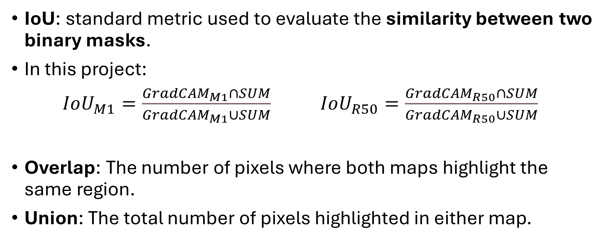
IoU as Comparison Method
IoU: standard metric used to evaluate the similarity between two binary masks.
In this project:
$IoU_{M1}=\frac{GradCAM_{M1}∩SUM}{GradCAM_{M1}∪SUM}$ $IoU_{R50}=\frac{GradCAM_{R50}∩SUM}{GradCAM_{R50}∪SUM}$
Overlap: The number of pixels where both maps highlight the same region.
Union: The total number of pixels highlighted in either map.

Slide 11
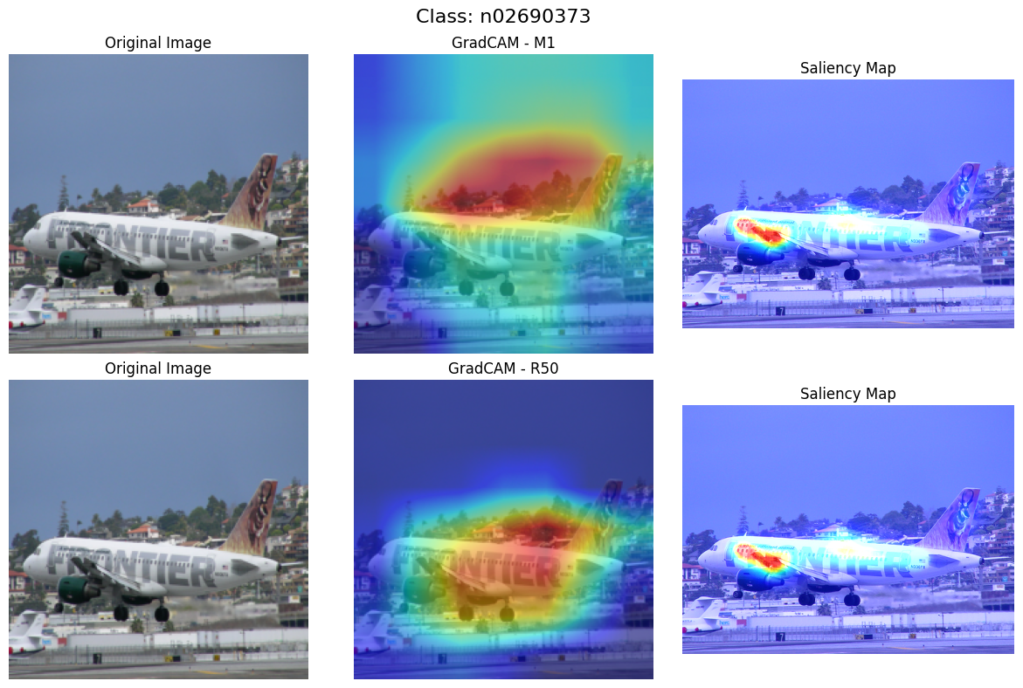
Results - Aircrafts
ResNet50 mostly performed better than our model

Slide 12
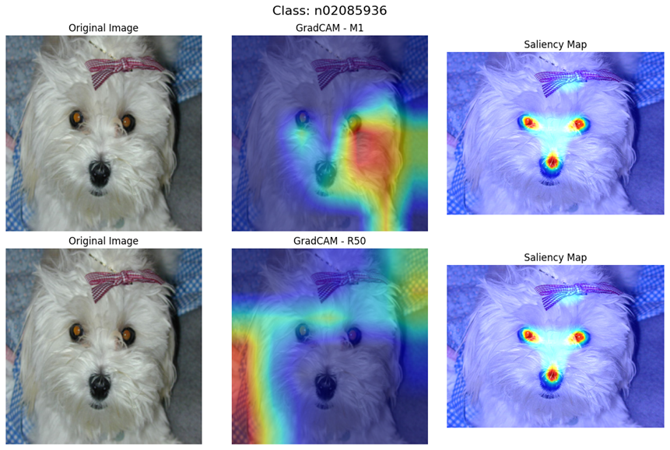
Results - Dogs
Our model mostly performed better than ResNet50

Slide 13
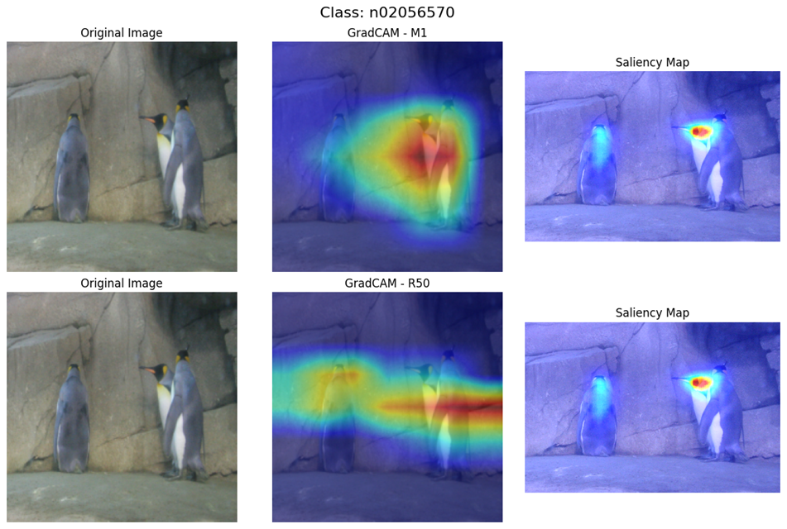
Results - Penguins
Performancesof the two models were comparable

Slide 14
IoU Results
Average IoU M1 vs SUM: 0.3982
Average IoU ResNet50 vs SUM: 0.2307
A possible explanation for these results is that the Saliency Maps generated by our model tend to be larger and more spread out, which increases their overlap with the SUM-generated saliency maps compared to those produced by ResNet50.
However, it's important to note that this does not necessarily reflect the accuracy of the model itself.

Slide 15




End of Presentation
Daniele Riccobene, Dario Scuderi

